Slide 1


Nebraska Drought Conditions:
CARC Update
July 17, 2023
Brian Fuchs
National Drought Mitigation Center
University of Nebraska-Lincoln
School of Natural Resources

Slide 2
Regional Climatic and Drought Conditions…

Slide 3
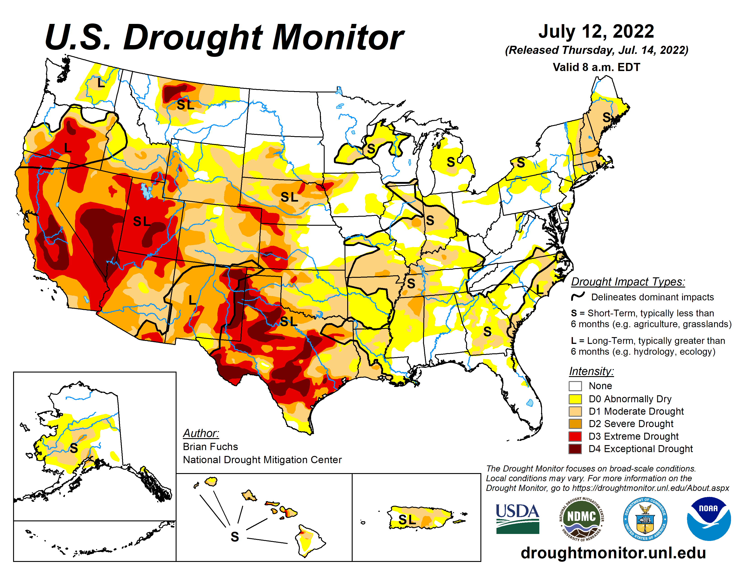
Last year at this time…..

Slide 4
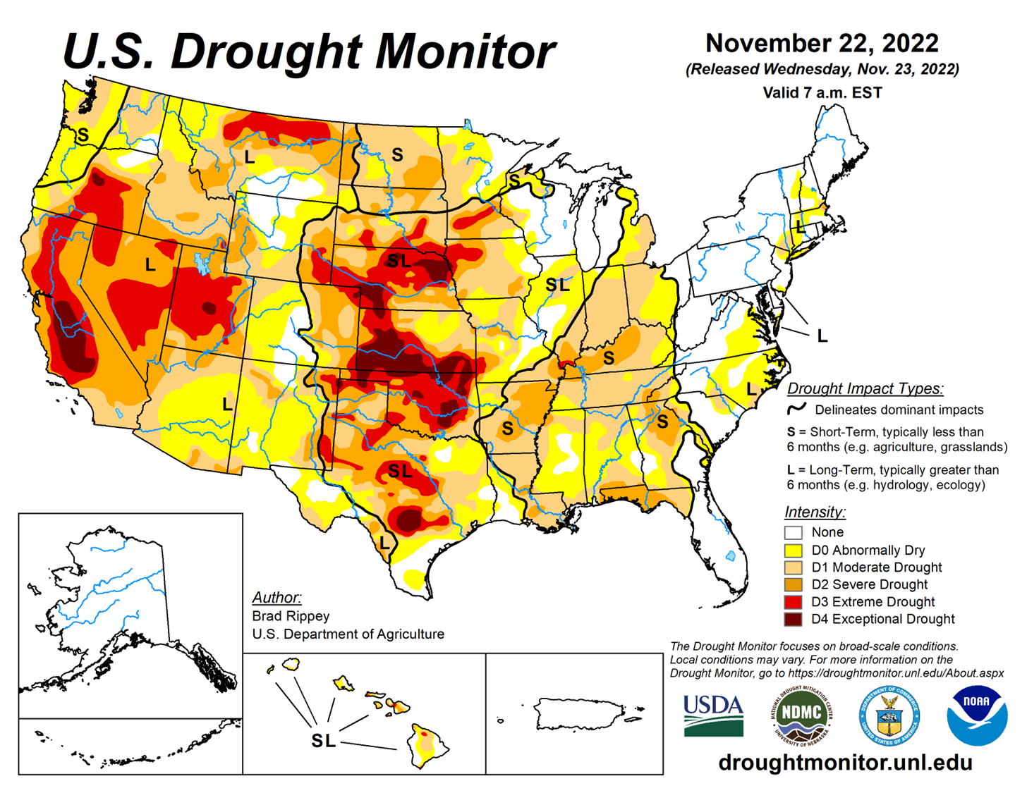
Last CARC Meeting…..

Slide 5
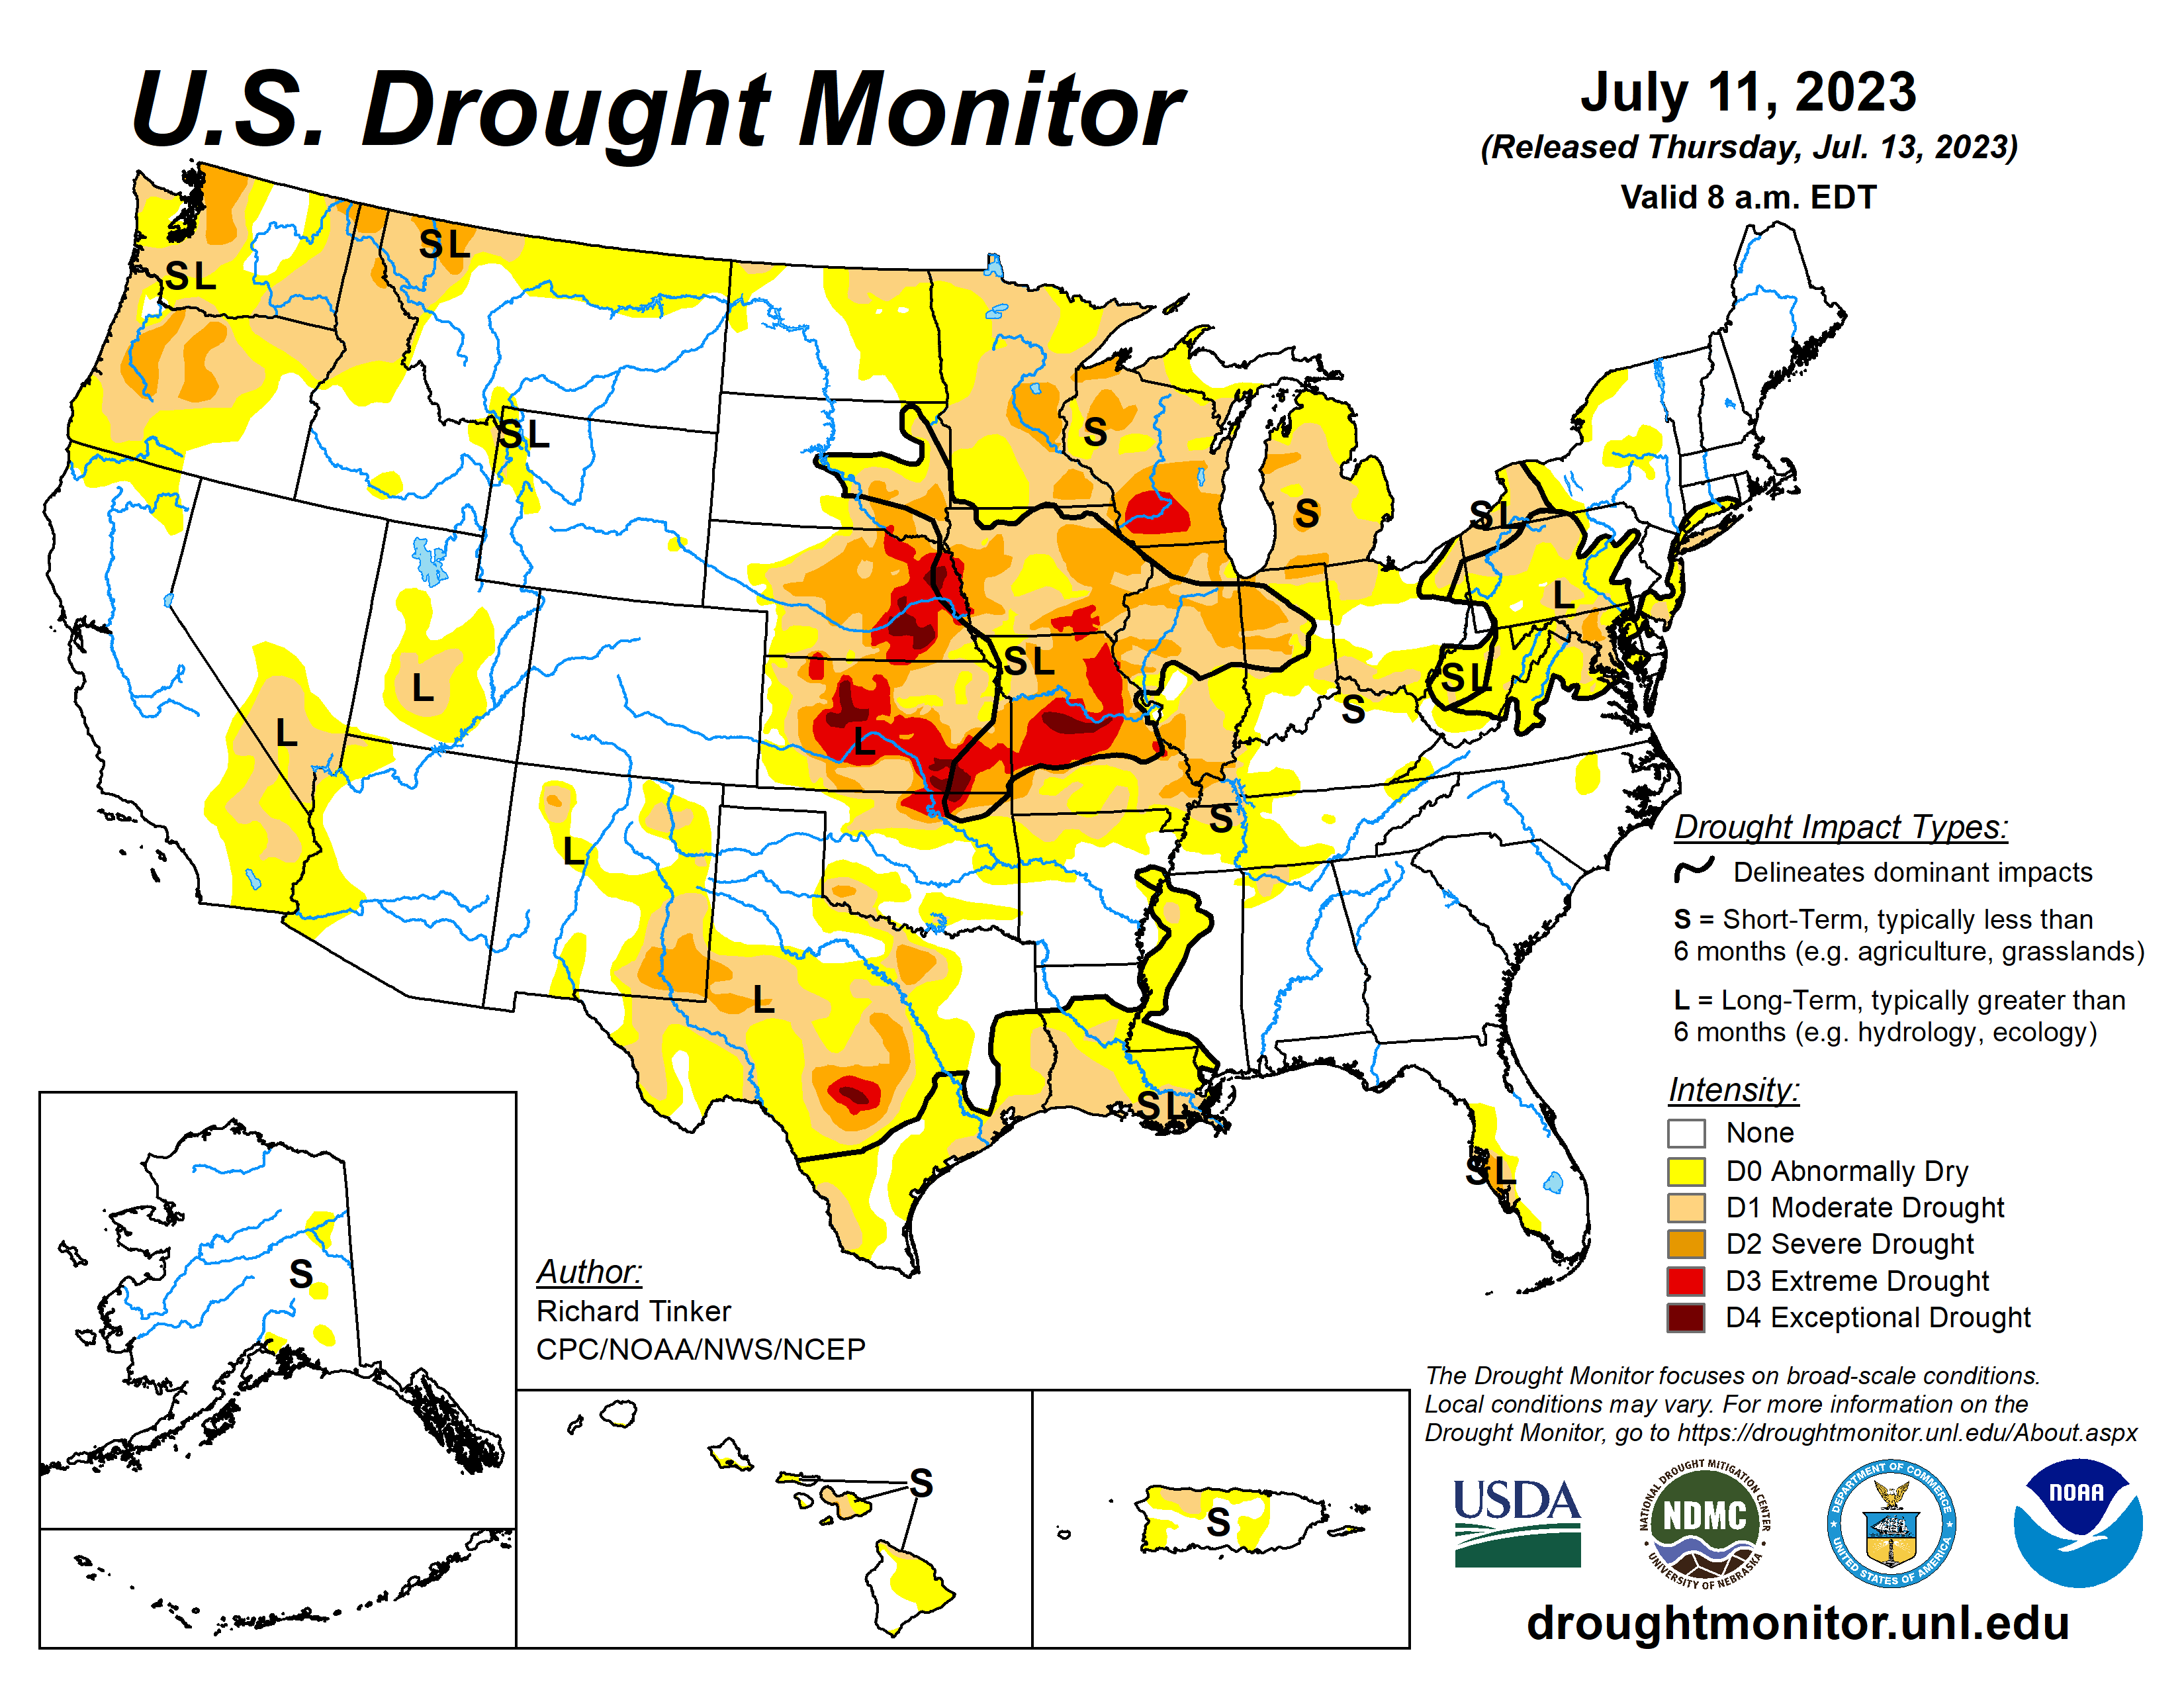

Slide 6
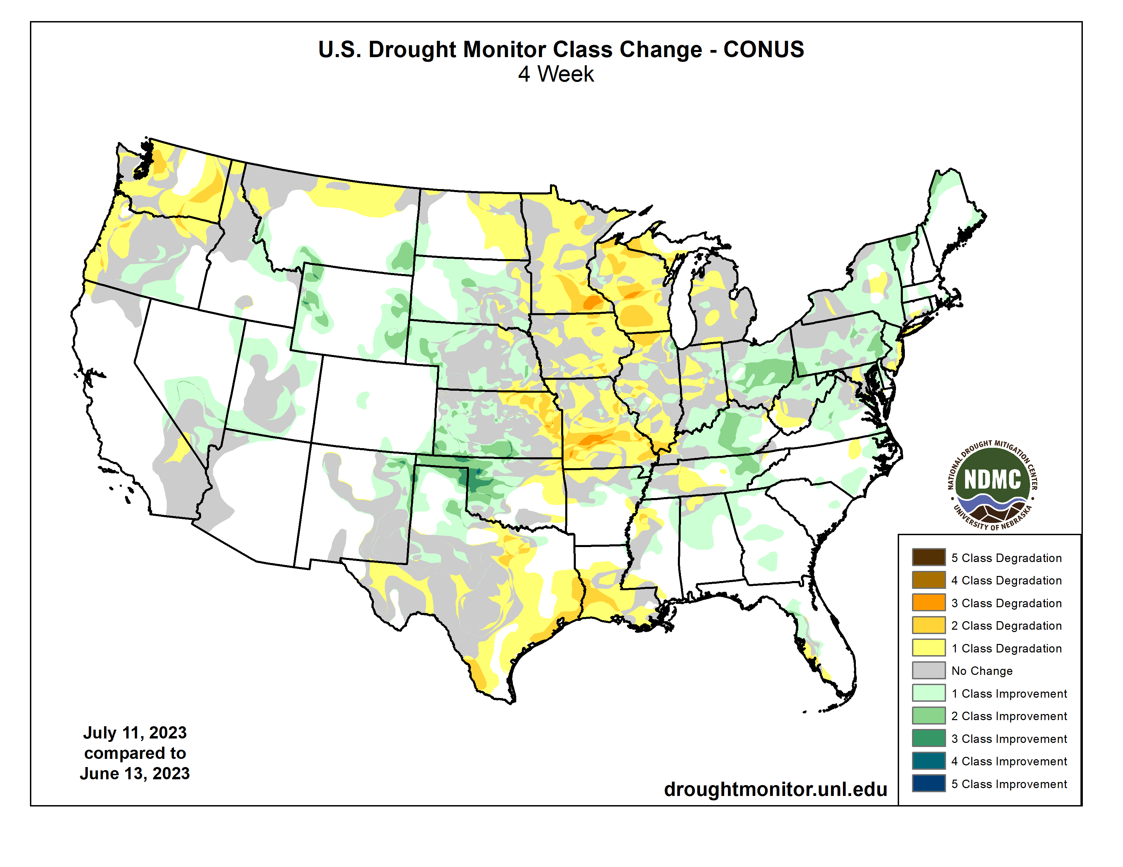

Slide 7
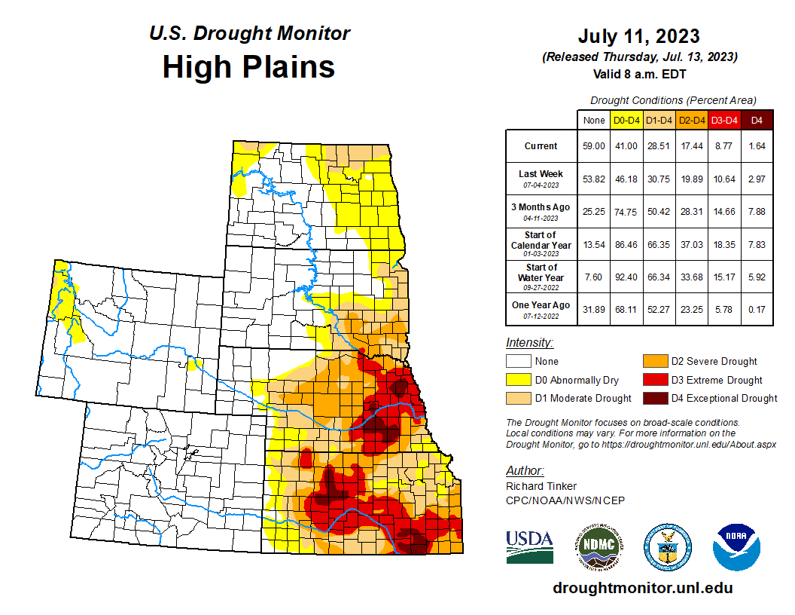


Slide 9
Last CARC meeting

Slide 10
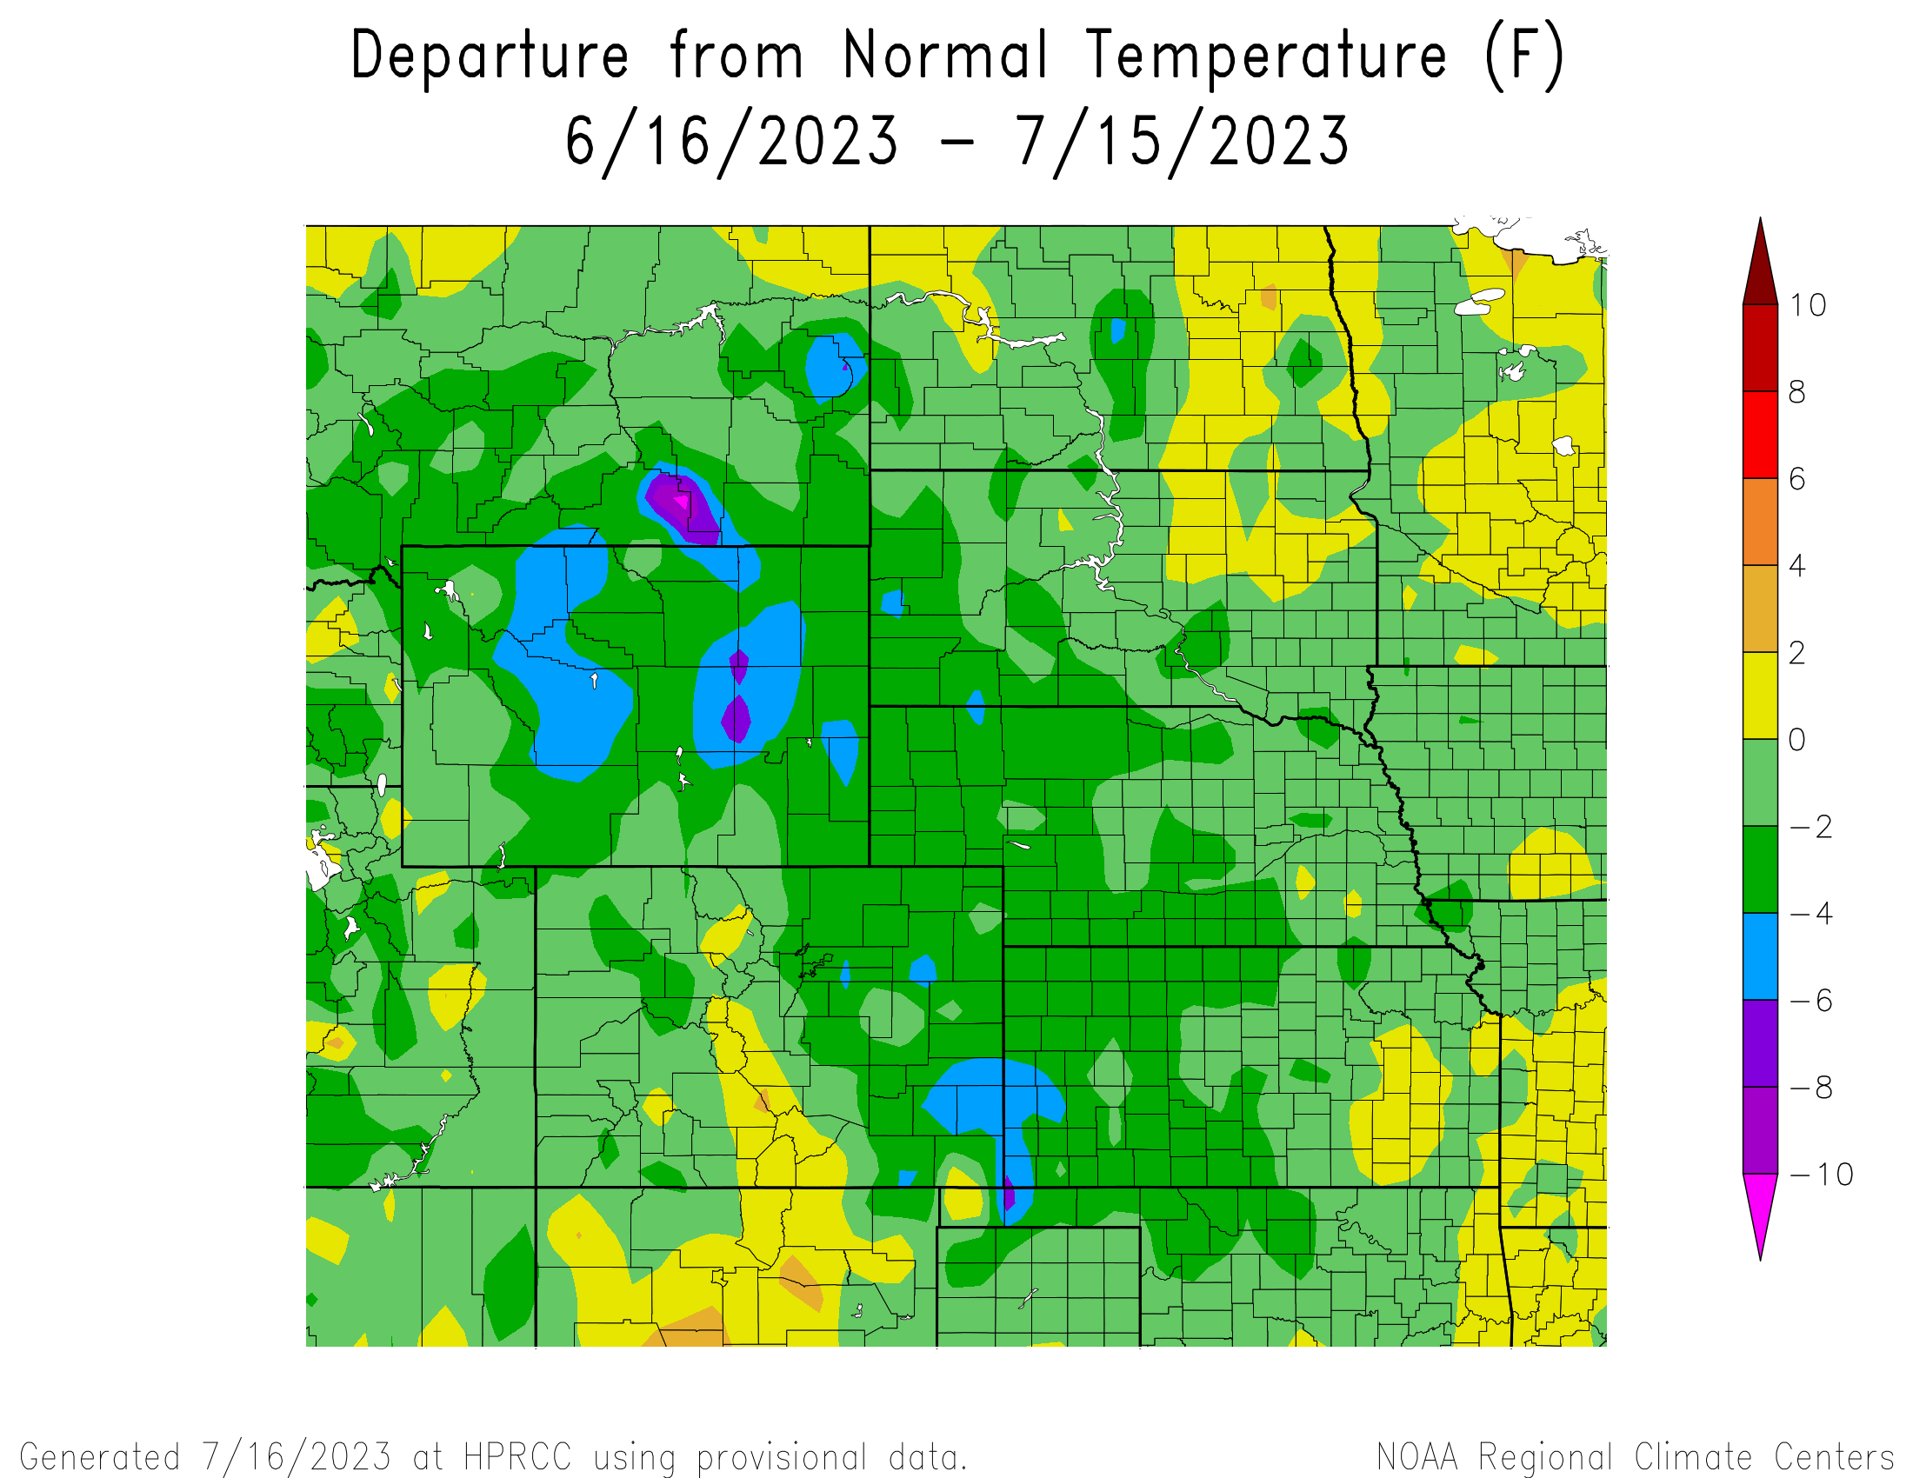
Departure from Normal Temperatures over the last 30 days

Slide 11
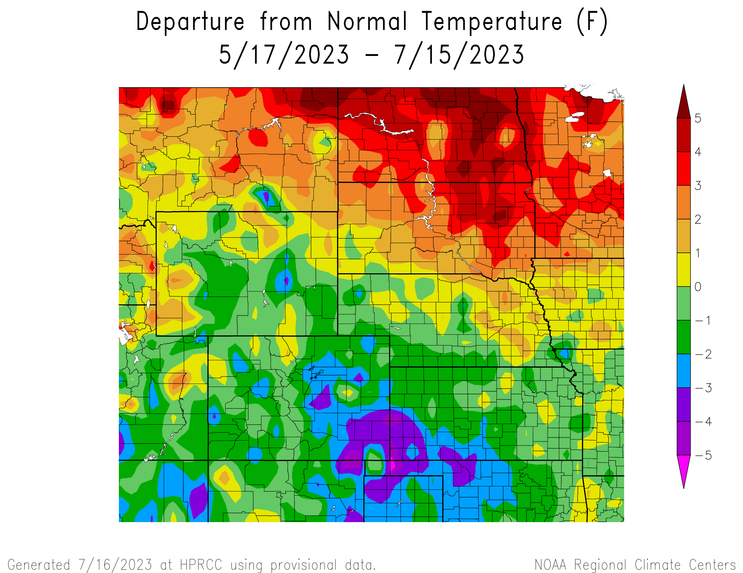
Departure from Normal Temperatures over the last 60 days

Slide 12
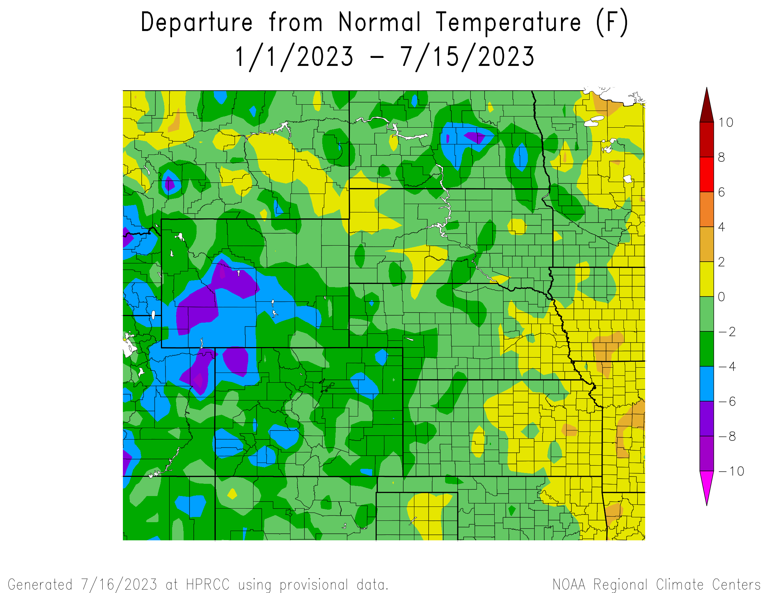
Departure from Normal Temperatures for the Calendar Year

Slide 13
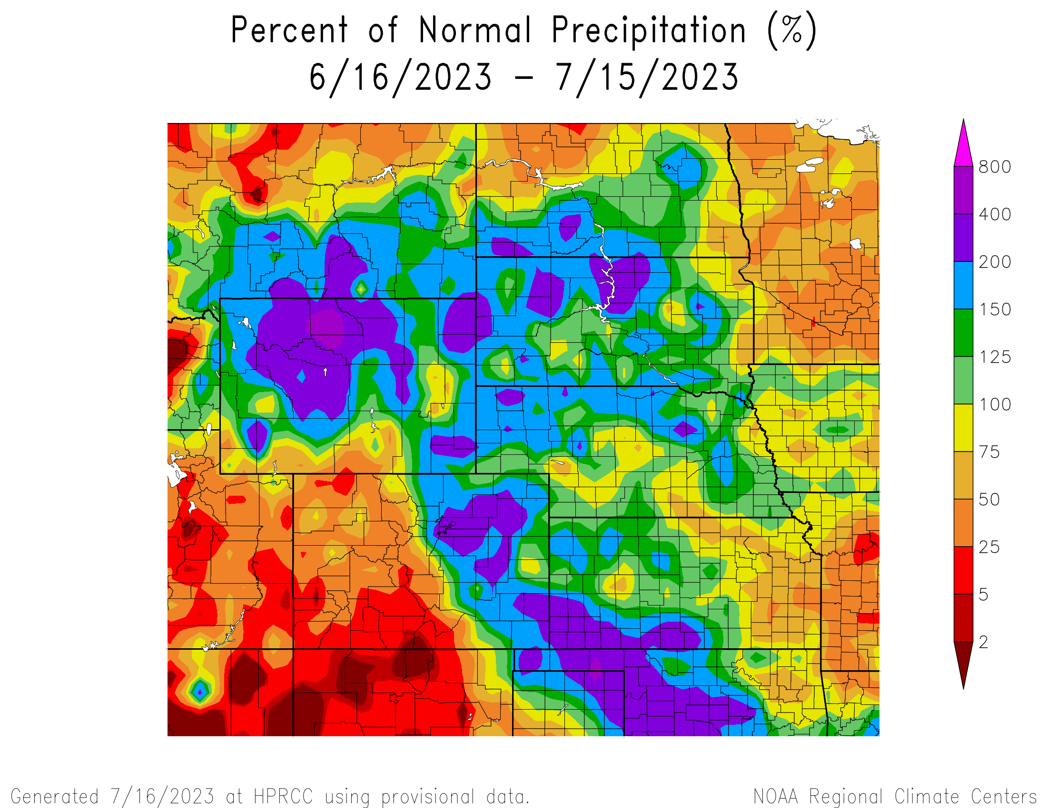
Percent of Normal Precipitation over the last 30 days

Slide 14
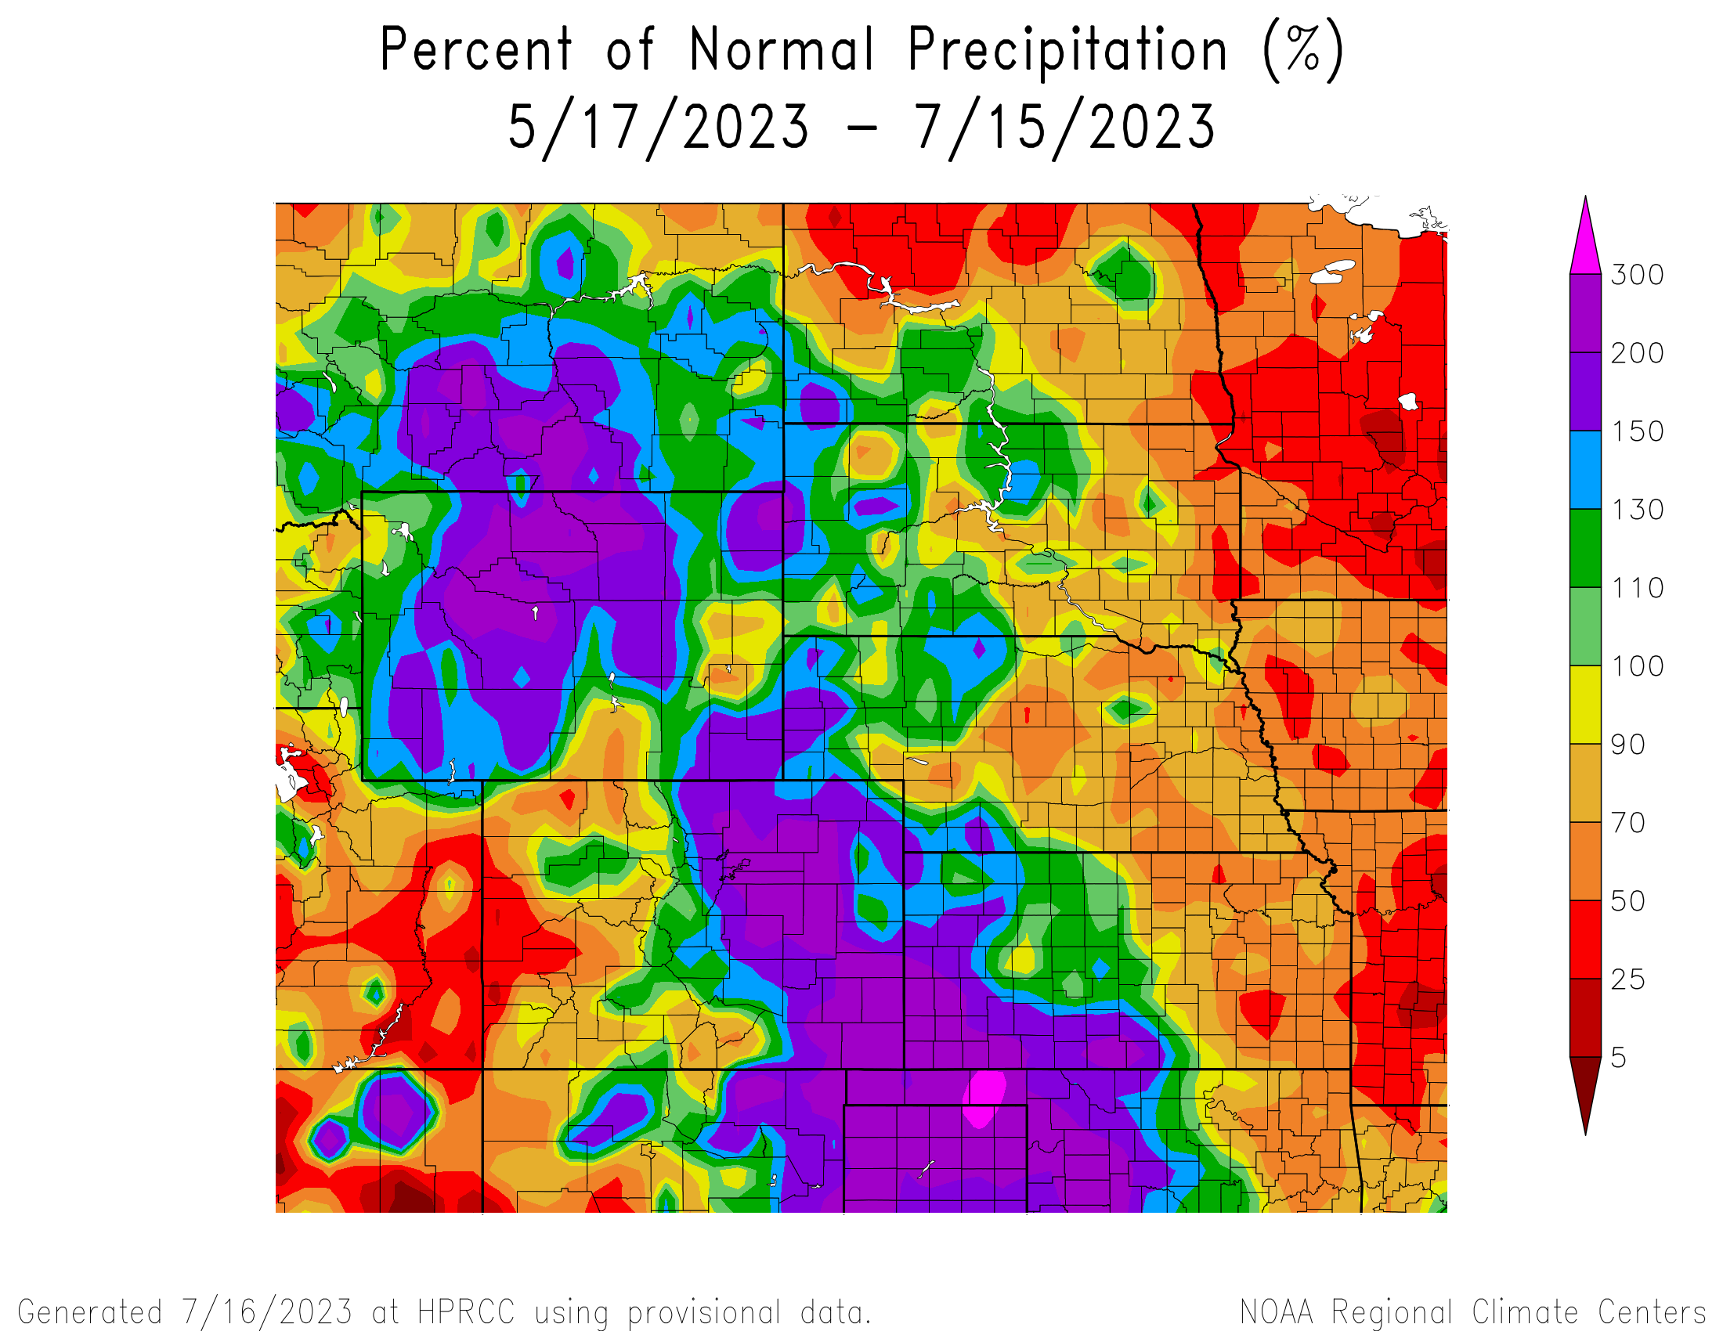
Percent of Normal Precipitation over the last 60 days

Slide 15
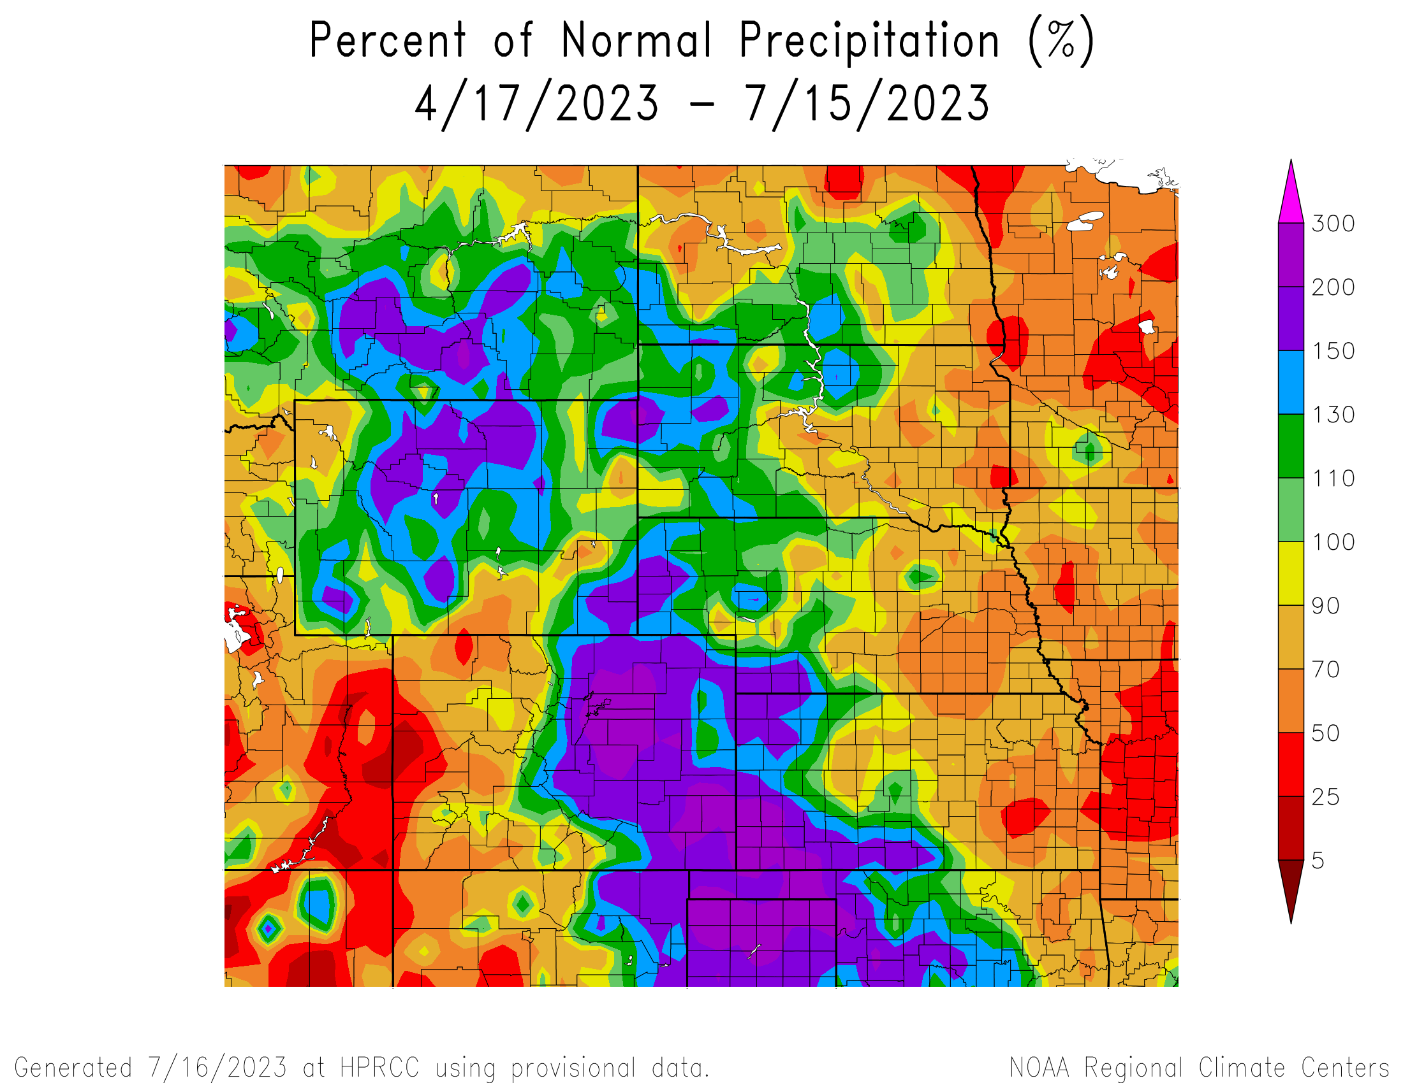
Percent of Normal Precipitation over the last 90 days

Slide 16
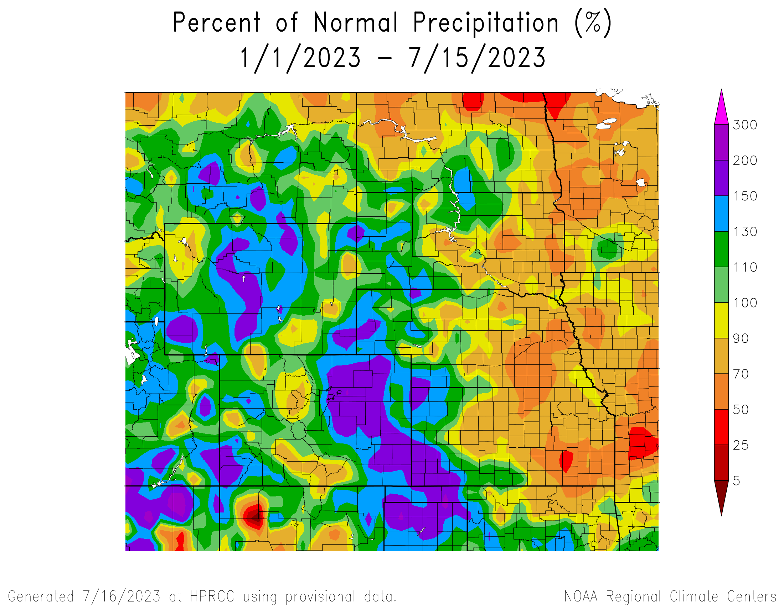
Percent of Normal Precipitation for the calendar year

Slide 17
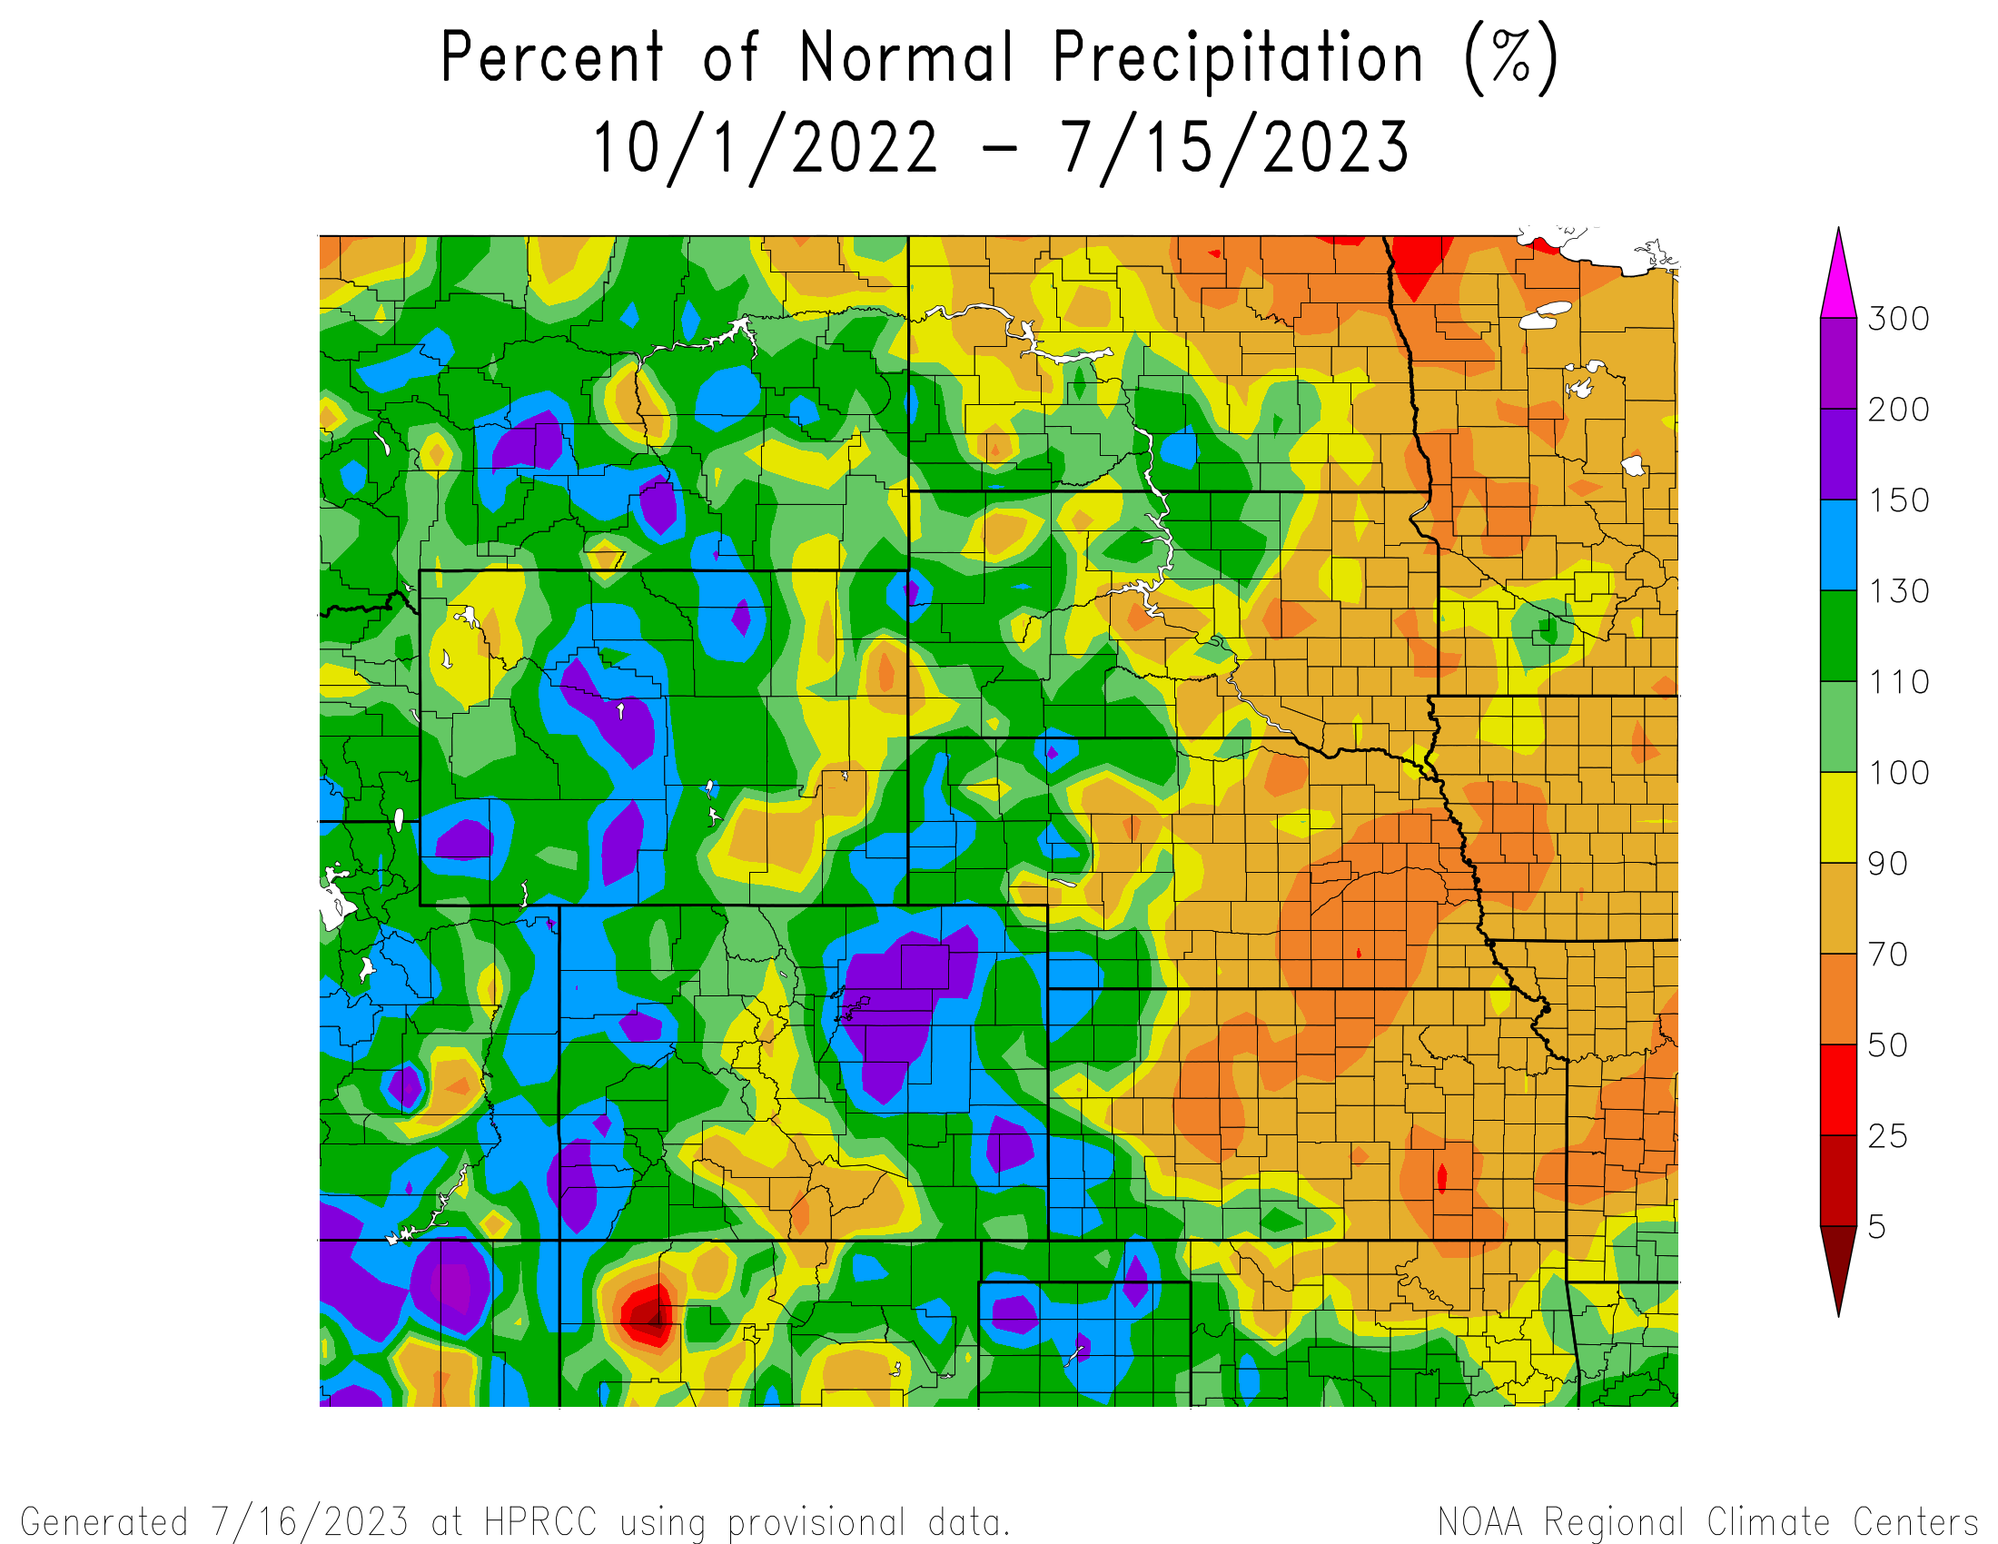
Percent of Normal Since October 1
2002
(water year)

Slide 18
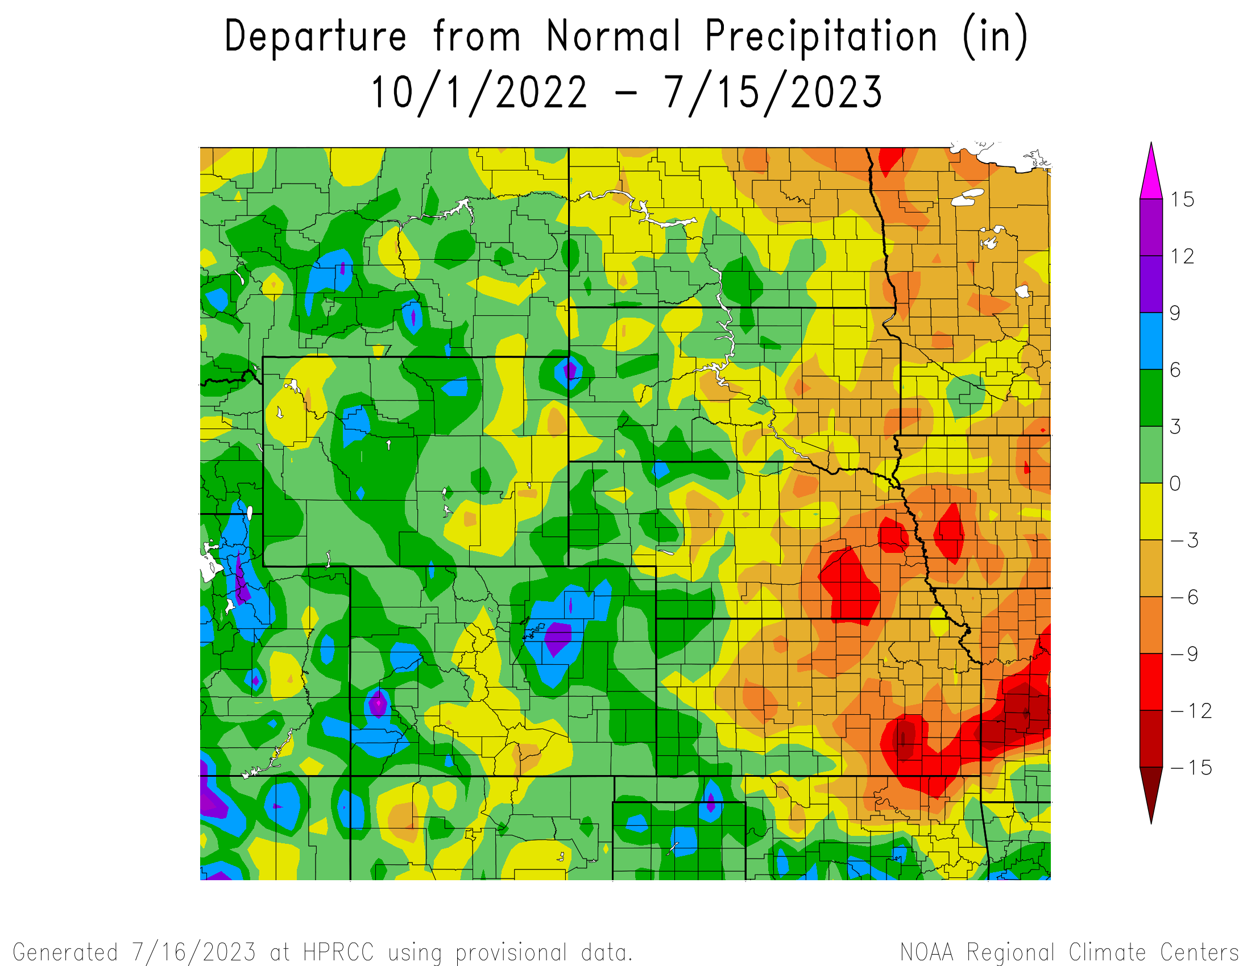
Departure from Normal Since October 1
2002
(water year)

Slide 19
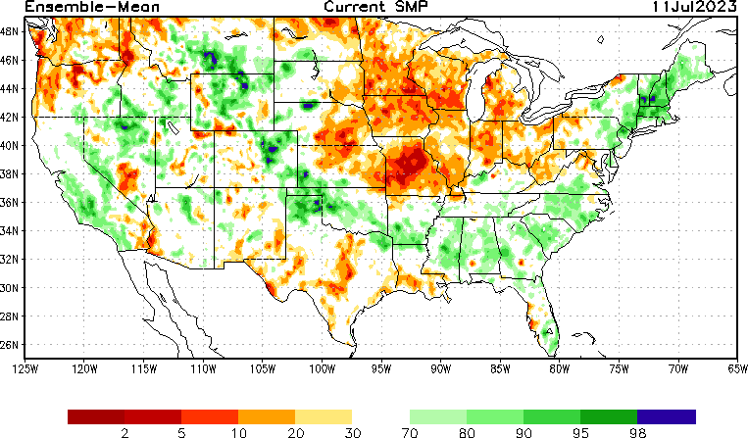
NLDAS Soil Moisture Model: Current Soil Moisture Anomaly

Slide 20
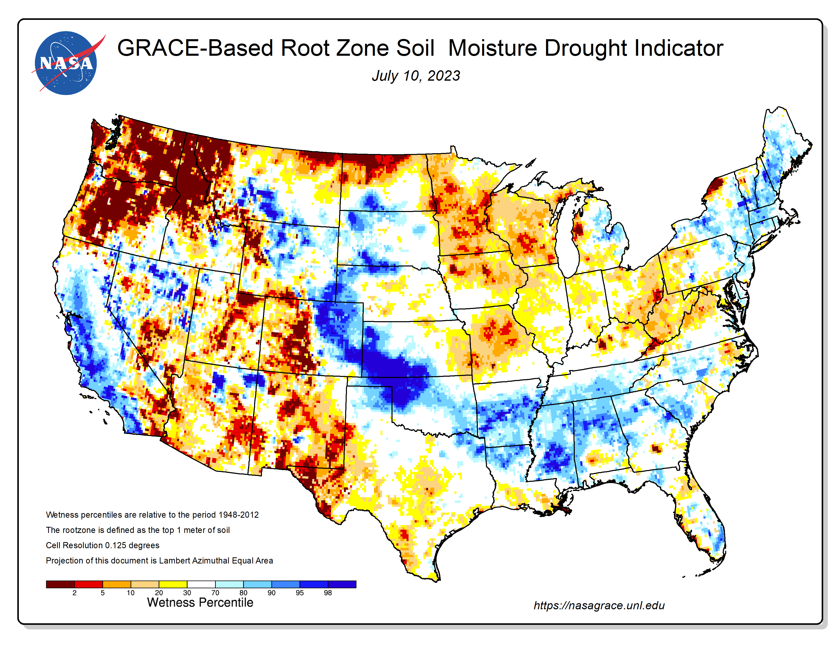
NASA GRACE-Based Root Zone Soil Moisture
https://nasagrace.unl.edu/

Slide 21
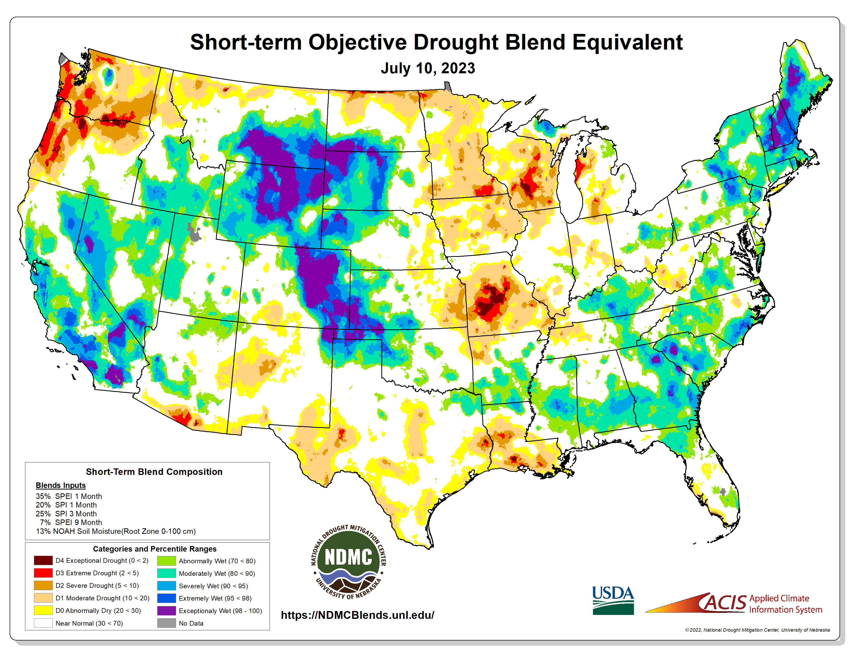
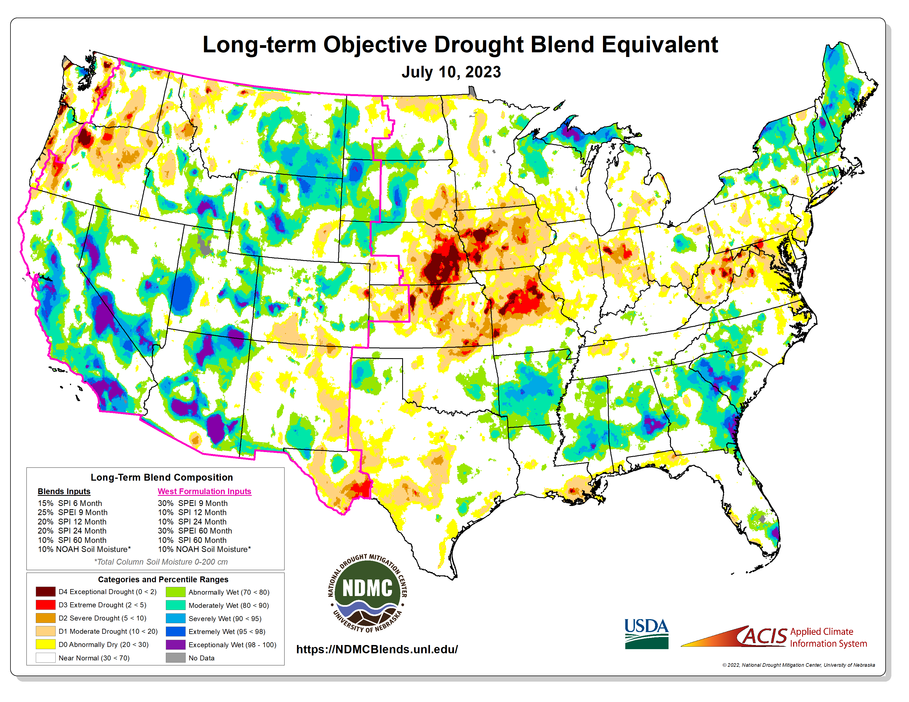
https://ndmcblends.unl.edu/
NDMC’s weekly Objective Blends for both short-term and long-term drought

Slide 22
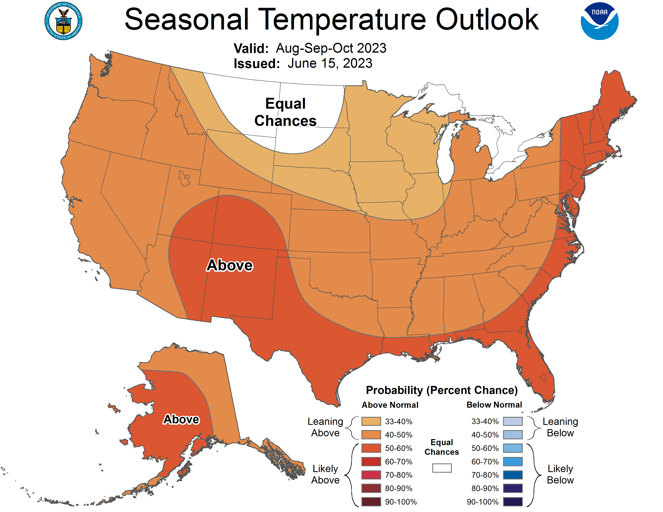
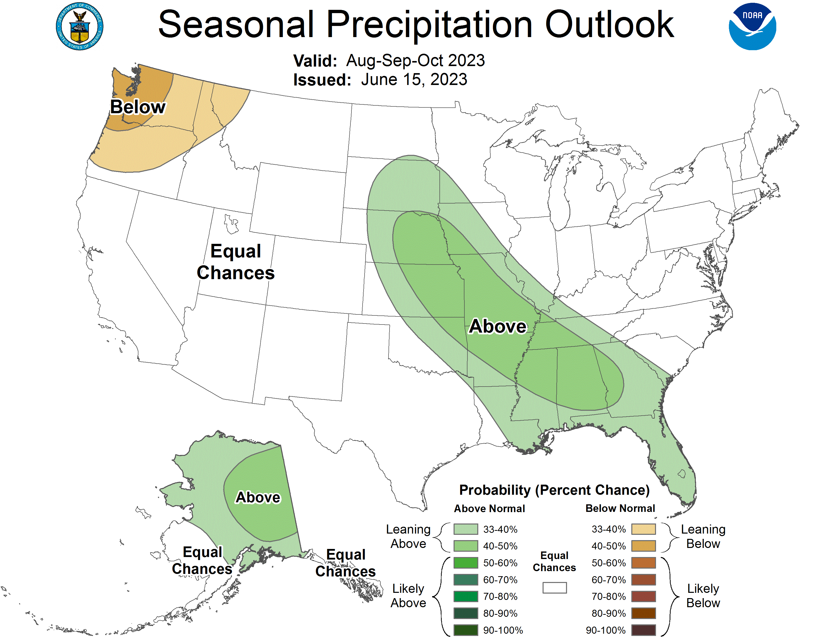
NOAA’s Official 3-Month Outlook

Slide 23
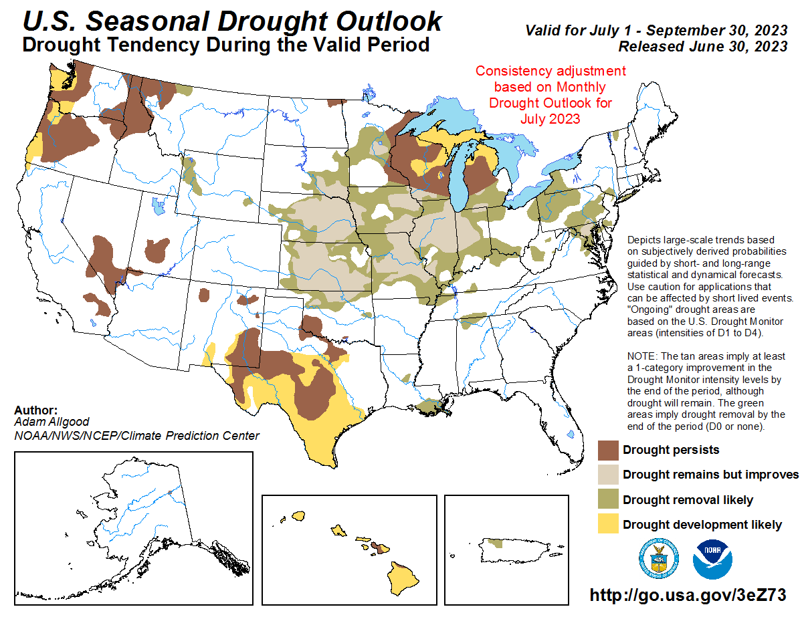

Slide 24
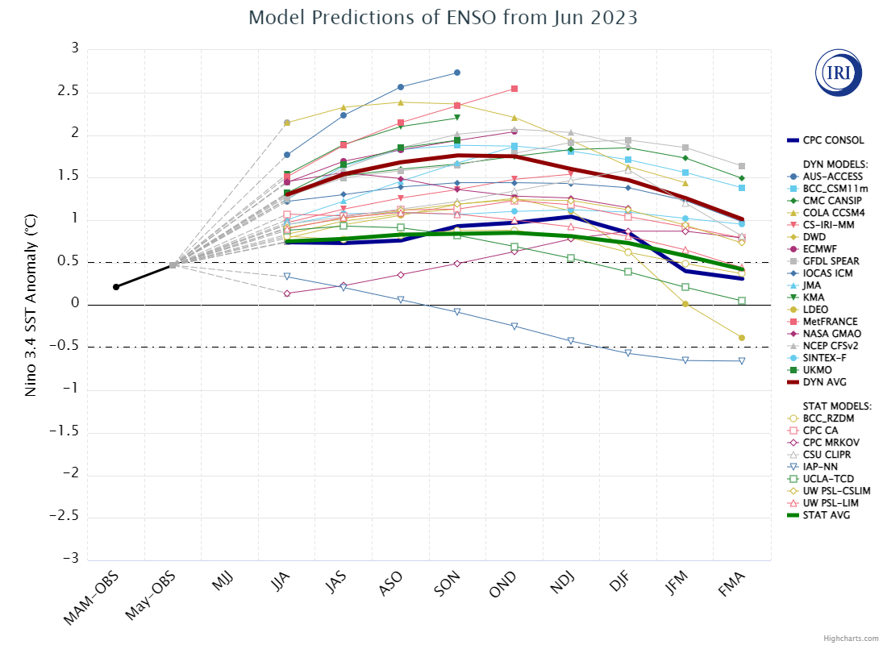
Anticipated El Nino Development?

Slide 25
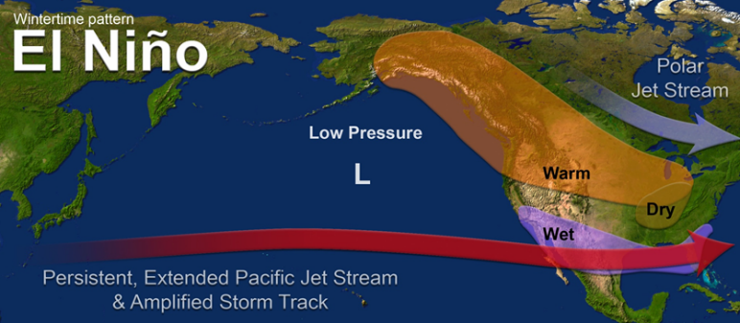
What does a typical El Nino pattern mean?
https://www.pmel.noaa.gov/elnino/sites/default/files/thumbnails/image/ElNinoJetWintertimePattern_NOAA_SRH.png

Slide 26
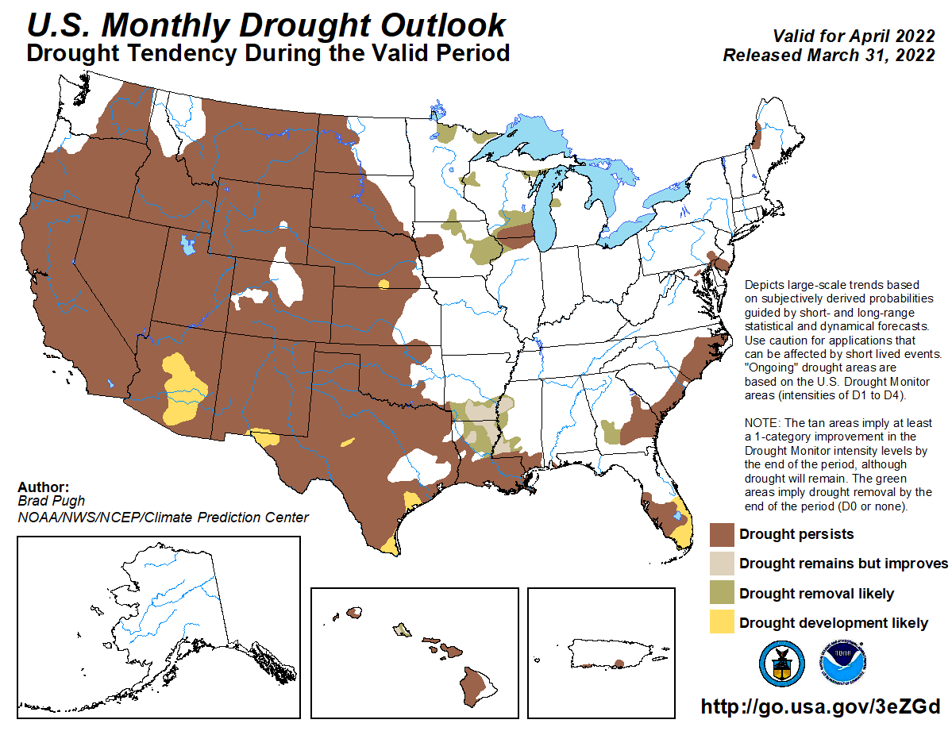

Slide 27
Climate/Drought Summary
Temperatures have been cooler than normal throughout the central to southern High Plains lately and near normal to slightly below for the calendar year. Over the last 60 days, most all the Dakota’s were 2-4 degrees above normal, while most of the southern High Plains was 2-3 degrees below normal.
Precipitation has been well below normal for the year over most of eastern Nebraska, eastern Kansas and the eastern portions of the Dakotas. The current pattern has brought above normal precipitation over much of Colorado and Wyoming as well as portions of western Kansas, the Nebraska Panhandle, and into the Black Hills of South Dakota.
A second autumn/winter with little to no soil moisture recharge has allowed the drought to develop and intensify rapidly in 2023. Even with the most recent rains, soil moisture levels are still lacking.
Nebraska is currently showing 67.99 percent of the state in drought with just under 48% in severe drought or worse. Areas of the Panhandle have had drought be eliminated with the recent pattern.
The seasonal drought outlook that goes through the end of September has current drought improving during this time for most all the region with drought development expected to our south in southern Texas. (NOTE: the seasonal drought outlook will be updated on 7/20/2023 this week)

Slide 28
Nebraska Water Supply Update…

Slide 29
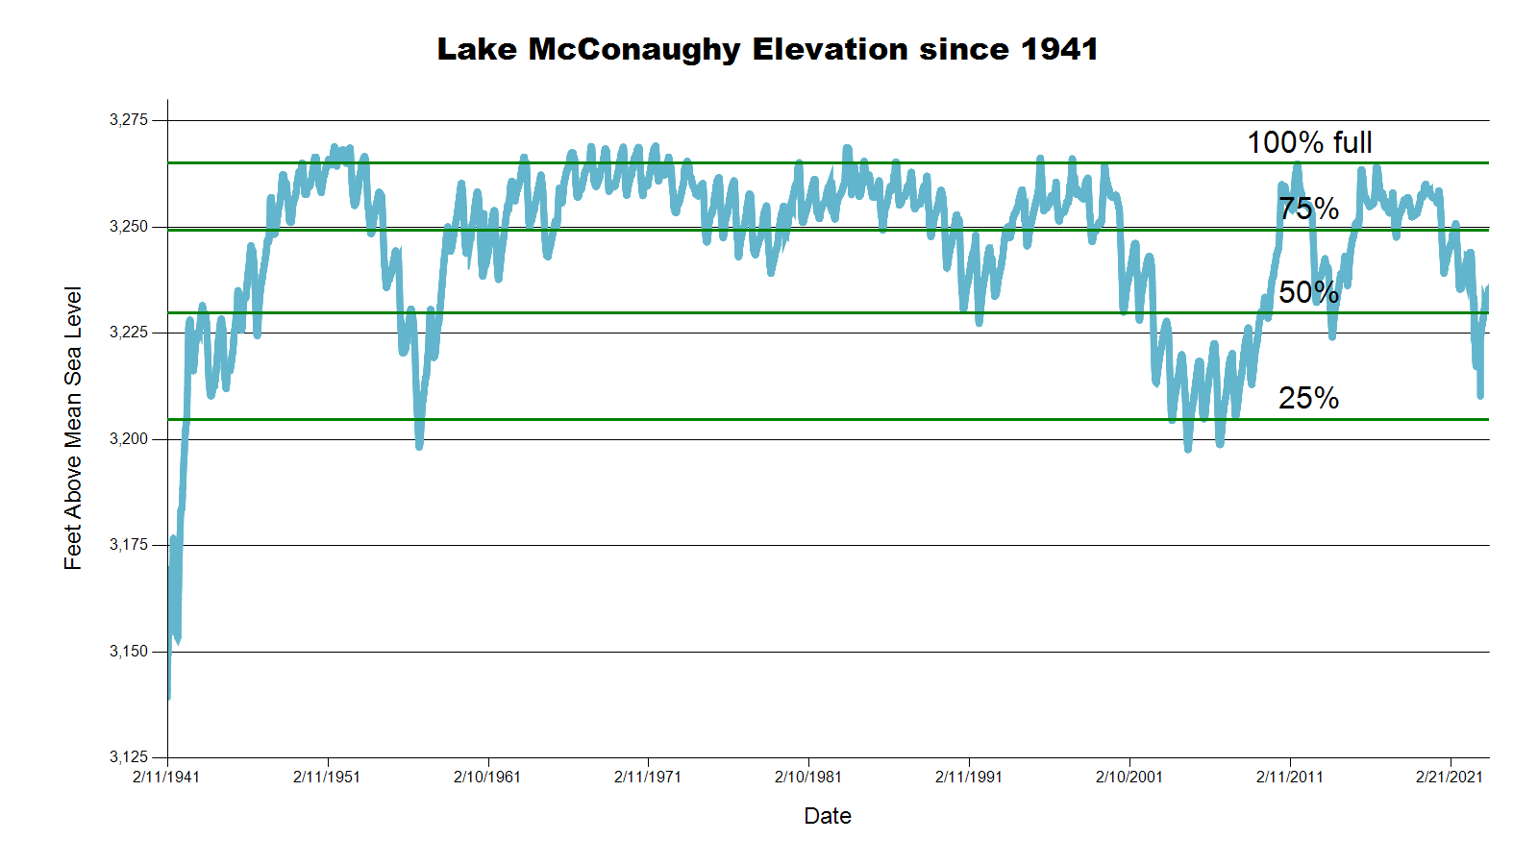
3235.7 feet 57.0% Full
SOURCE: CNPPID www.cnppid.com

Slide 30
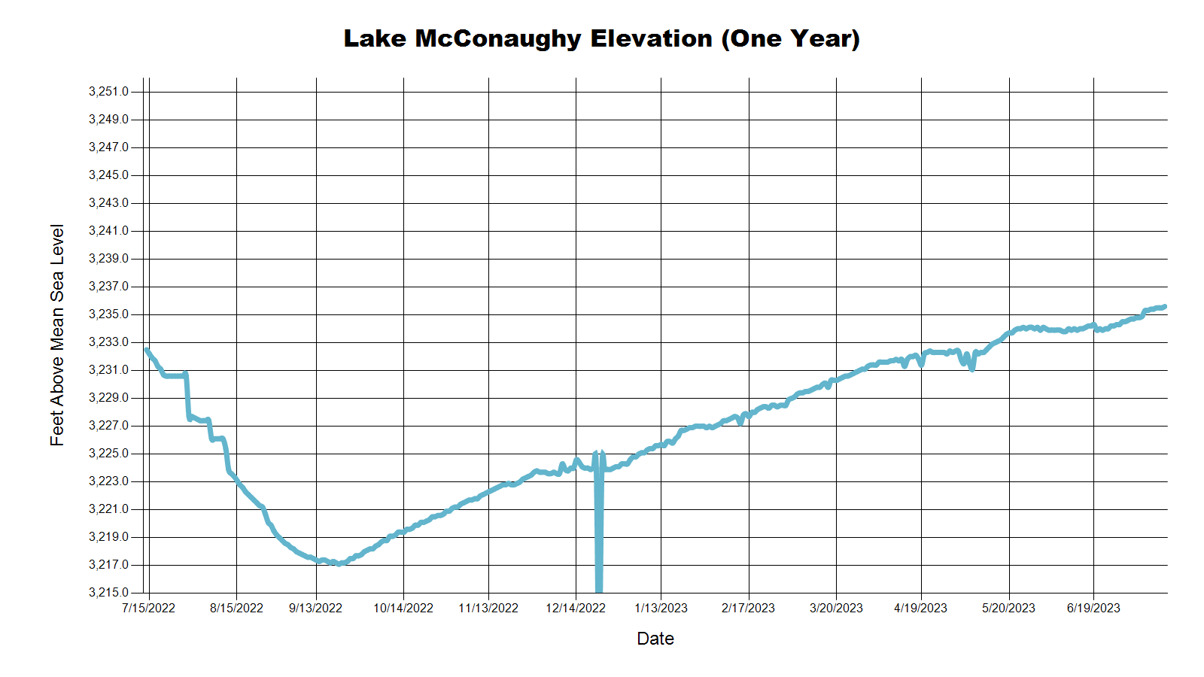
3235.7 Feet
57.0% of Max
July 2022
3223.2 Feet
42.7% of Max
November 2022
SOURCE: CNPPID www.cnppid.com

Slide 31
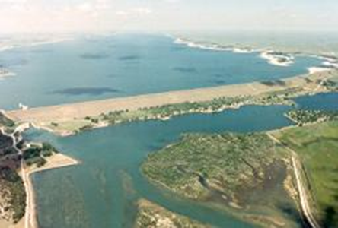
July 2023CARC Meeting
SOURCE: CNPPID www.cnppid.com

Slide 32
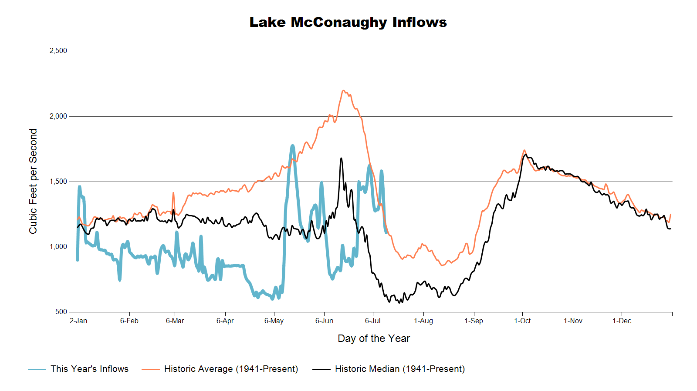

Slide 33
Lake McConaughy
Civil engineer Tyler Thulin reported that Lake McConaughy’s elevation currently is 3,234.9 feet (976,700 acre-feet, or 56% of maximum volume). This elevation is up 0.9 feet from the June meeting and Thulin reported that normally at this time of year the elevation would have dropped four to five feet. Inflows are around 1400 cubic feet per second (cfs), which is up 500 cfs in the past two weeks and outflows are about 900 cfs. Thulin also reported that flows in the South Platte River continue to be at a very high level and that should last for at least the next week. All current water passing through Central’s diversion dam is from the South Platte. Current outflows from McConaughy are being released for Gerald Gentleman Station cooling and for irrigation in the Glendo canals.
SOURCE: CNPPID News Release July 6, 2023
www.cnppid.com

Slide 36
North Platte Basin data
https://www.usbr.gov/gp/lakes_reservoirs/wareprts/main_menu.html#supply

Slide 37
North Platte River Basin Inflow

Slide 38
North Platte River Basin Storage

Slide 39
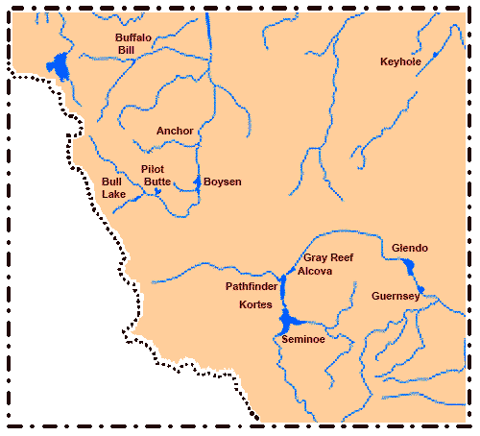
North Platte River Basin
Seminoe: 83.4% of conservation pool, 45.9% last CARC meeting
Pathfinder: 66.0% of conservation pool, 31.2% last CARC meeting
Glendo: 90.0% of conservation pool, 36.7% last CARC meeting
Alcova: 98.0% of conservation pool, 85.1% last CARC meeting
Source: BOR https://www.usbr.gov/gp/lakes_reservoirs/wyoming_lakes.html

Slide 40
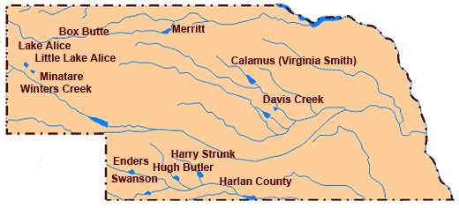
Republican River Basin
Hugh Butler: 44.6%(29.1%) of conservation pool
Enders: 19.8% (14.9%) of conservation pool
Harry Strunk: 94.5% (47.3%) of conservation pool
Swanson: 49.9% (N/A) of conservation pool
*values in red are from the last CARC meeting
Source: BOR http://www.usbr.gov/gp/lakes_reservoirs

Slide 41
Republican River Basin
Harlan County Current Conditions
Conservation Pool is 78.8% full (71.9%)
247,516 Acre-Feet in storage compared to 225,693 Acre-Feet (AF) of water in storage during November 2022
Last year at this time, 291,658 AF was in storage (July 2022)
Historical average storage for this time of the year is 268,143 AF
*values in red are from the last CARC meeting
Source: BOR http://www.usbr.gov/gp/lakes_reservoirs/

Slide 42
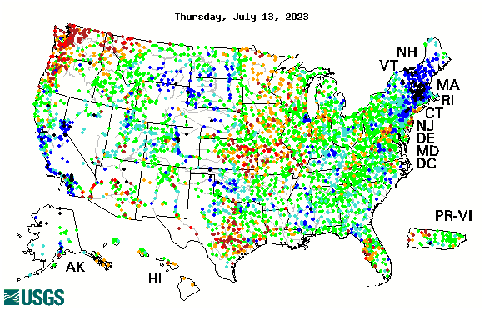

14-day average streamflow compared to historical streamflow for the day of year

Slide 43
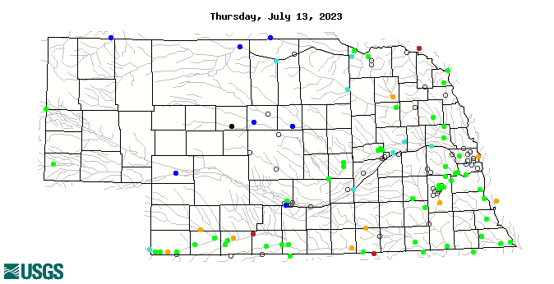
14-day average streamflow compared to historical streamflow for the day of year
91st Percentile
37th Percentile
64th Percentile
17th Percentile
6thPercentile
13thPercentile

Slide 44
Water Supply Summary
Lake McConaughy is currently 57.0 percent of capacity and has been slowly rising with the influx of runoff from the Rocky Mountains, even as irrigation season has started.
Upstream reservoirs in Wyoming are near capacity for this time of year with most sending water downstream. The South Platte River is running well above normal with the runoff and precipitation taking place in the basin.
The Republican River basin reservoirs all have more water in storage than in November. Timely precipitation in June and July has reduced irrigation demand to this point in the growing season.
Harlan County Reservoir is holding about 22,000 acre-feet more water now than in November 2022 and is also holding about 21,000 acre-feet less than the historical average for this time of year.

Slide 45
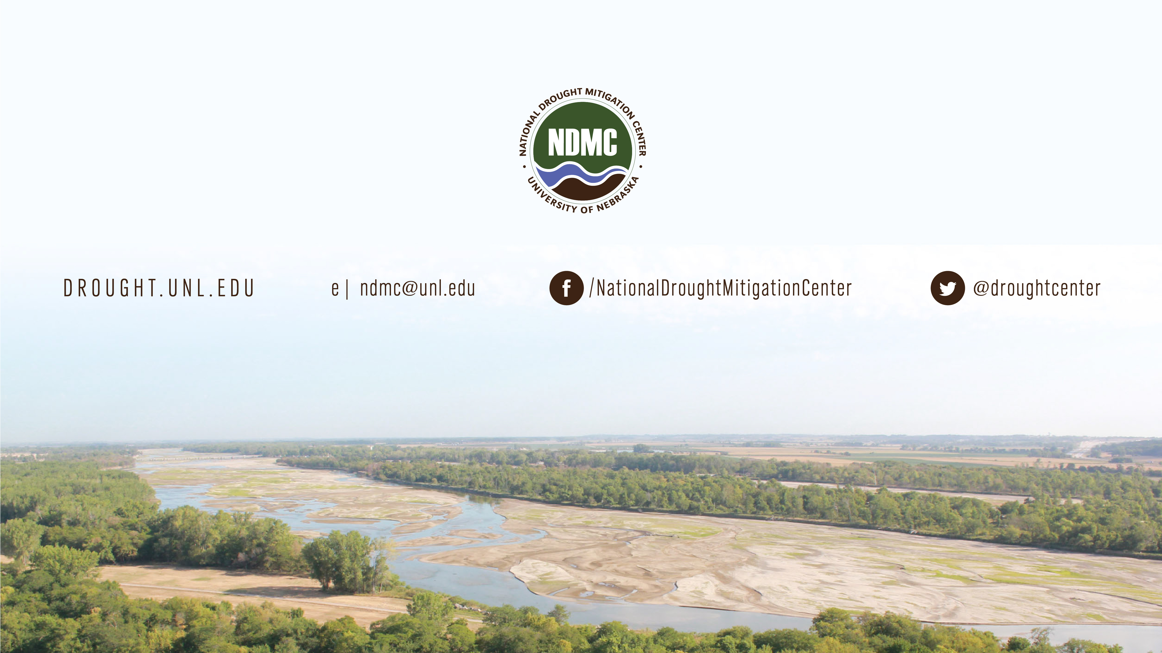
Brian Fuchs
bfuchs2@unl.edu
402-472-6775
National Drought Mitigation Center
School of Natural Resources
University of Nebraska-Lincoln

